Slide 1
Logistics Operation Analyst
Presentation by Brunna Meira Pinheiro

Slide 2
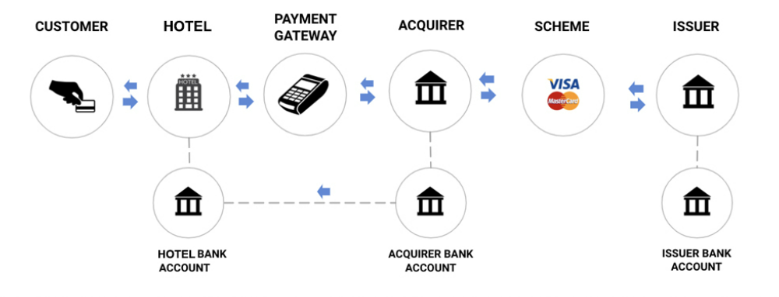

Understanding
the Industry
Main Players:
Consumer: buyers/clients
Merchant: Service or product provider
Payment Gateway: system that connects merchants and acquirers
Acquirer: Payment Processor (Cloudwalk)
Scheme: Credit Card Brand
Issuer: Issuing Bank (Card)
MERCHANT
MERCHANT BANK
ACCOUNT
Font: https://www.hotellinksolutions.com/understanding-all-basics-about-payments-101/ (edited)
Notes:
Information flow: Customer provides Cards Data to Merchant (online or physical), The payment gateway makes the connection sending this information to the next players, the acquirer receives the information and sends information to scheme which then sends the information to issuer which will verify the funds of the customer and approve the sale (it may happen one or many anti-fraud checks during this process)
Money Flow: After approval the issuer will send the money from the issuer bank account (debit) or the scheme will send the funds (credit - if there is limit available), the acquirer receives it and send this money directly to merchant bank account discounted the fees from the whole process (fees can be applied from acquirers, schemes or issuer banks)

Slide 3
Understanding
the Industry
Acquirer: Payment Processor (Cloudwalk)
Sub-acquirer: Intermediary player between merchant and acquirer
Payment Gateway: system that connects merchants and acquirers
SUB-ACQUIRER
MERCHANT
MERCHANT BANK
ACCOUNT
Font: https://www.hotellinksolutions.com/understanding-all-basics-about-payments-101/ (edited)
Notes:
A sub-acquirer is a company that processes payments and transmits the generated data to the other players involved in the payment flow. Its role is similar to that of an acquirer, but it doesn't completely replace it due to the lack of autonomy to perform all the funcilnatilies of an acquirer.
A sub-acquirer can therefore be understood as a kind of intermediary player between acquirer and store.
The main advantages of a sub-acquirer are its low implementation cost , own anti-fraud system and ease of integration which makes this a very attractive solution for small stores. On the other hand, the choice of using the sub-acquirer may jeopardize the retailer's profits because of the high rates charged for each transaction (greater than the acquirers).
Another negative factor for retailers is the redirection of the customer to the sub-acquirer's own page during the final steps of the checkout, which can lead to higher withdrawal rates.

Slide 4
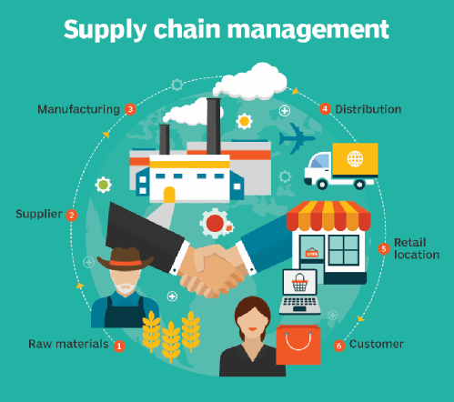
Understanding
the Industry
Supply Chain in the Payment Industry
Production and Delivery of Products involved in Payment (such as Card Machines, Cards etc)
Improvement of Supply Chain processes for merchants and/or industries
Companies involved in the Payment Ecosystem may be providers of better means of payment for retailers and service providers as well as industries and their suppliers (faster and safer)
Font: https://www.techtarget.com/searcherp/definition/supply-chain-visibility-SCV
Notes:
Explain the two points - Supply Chain in the Payment Ecosystem and Understanding the supply Chain Management and helping improving it

Slide 5

Understanding
the Industry
Logistics in the Payment Industry
Agile delivery of card machines:
Faster improvement of payment methods for merchants
Increased sales for merchants
Better reputation of card machine company and increased loyalty of merchants
More time to collect data and analyse usage and results of card machines
Opportunity to create Ads or marketing promotions focused on fast deliveries
Font: https://www.odtap.com/5-top-technology-trends-in-transportation-and-logistics-industry/
Notes:
Focus on clients as well as the payment company

Slide 6
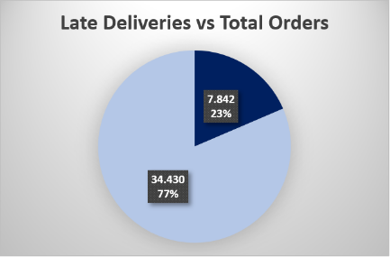
Analyzing
delivery data
Logistics Performance Analysis
Anomalous Behaviour:
23% of orders delivered after estimated date of delivery
*1,34% of data without estimate delivery date
Notes:
Gráficos SQL e Análise de anomalias encontradas

Slide 7
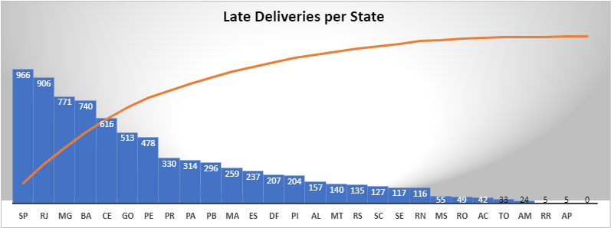
Analyzing
delivery data
Anomalous Behaviour:
23% of orders delivered after estimated date of delivery
Half of late deliveries in SouthEast region and Bahia Estate
Notes:
Gráficos SQL e Análise de anomalias encontradas

Slide 8
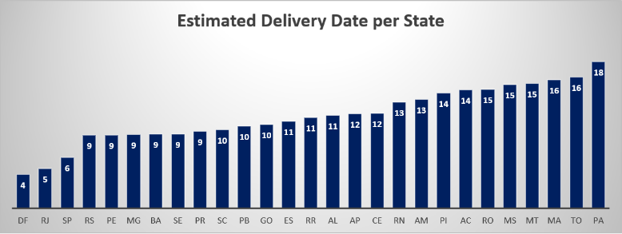
Analyzing
delivery data
Anomalous Behaviour:
23% of orders delivered after estimated date of delivery
Half of late deliveries in SouthEast region and Bahia Estate
Regions with lowest delivery date estimates (5-9 days)
Notes:
Gráficos SQL e Análise de anomalias encontradas

Slide 9
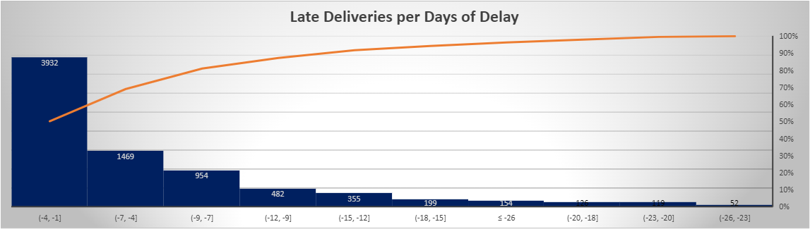
Analyzing
delivery data
Anomalous Behaviour:
23% of orders delivered after estimated date of delivery
Half of late deliveries in SouthEast region and Bahia Estate
Regions with lowest delivery date estimates (5-9 days)
50% of delayed orders between 1-4 days of delay
Notes:
Reinforcement of error in calculation of estimate delivery date for this region

Slide 10
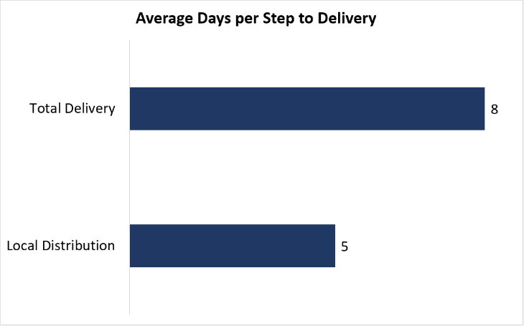
Solving
the problem
Logistics Performance Analysis
We make deliveries from a nationally structured logistics partner with distribution centers and delivery partners strategically spread to serve all zip code ranges in the country. Based on the data already analyzed, what would you do to reduce the average delivery time to 3 days?
Steps of Action Plan (Logistics):
Remove the local distribution step from delivery to client
Define demand for each Local Distribution
Provide product stocks according to demand
Guarantee stocks in Local Distribution before placement of orders
Notes:
Análise dos dados e solução do problema apresentado

Slide 11
Solving
the problem
Logistics Performance Analysis
We make deliveries from a nationally structured logistics partner with distribution centers and delivery partners strategically spread to serve all zip code ranges in the country. Based on the data already analyzed, what would you do to reduce the average delivery time to 3 days?
Steps of Action Plan (Commercial + MKT)
Improvement of demand planning by region or city (as specific as possible)
Marketing promotions focused on anticipated sales (reservations or pre-sale) in order to improve demand planning and delivery dates estimates
Notes:
Análise dos dados e solução do problema apresentado

